Slide 1
YOU MATTER
Building Stronger Membership Through Belonging
Every Legionnaire. Every Veteran. Every Family. Every Community. Every Day.
James Olson • Department Membership Director
The American Legion, Department of Minnesota

Slide 2


Slide 3
3
WE ARE
LEGIONNAIRES.
Everything else begins there.

Slide 4
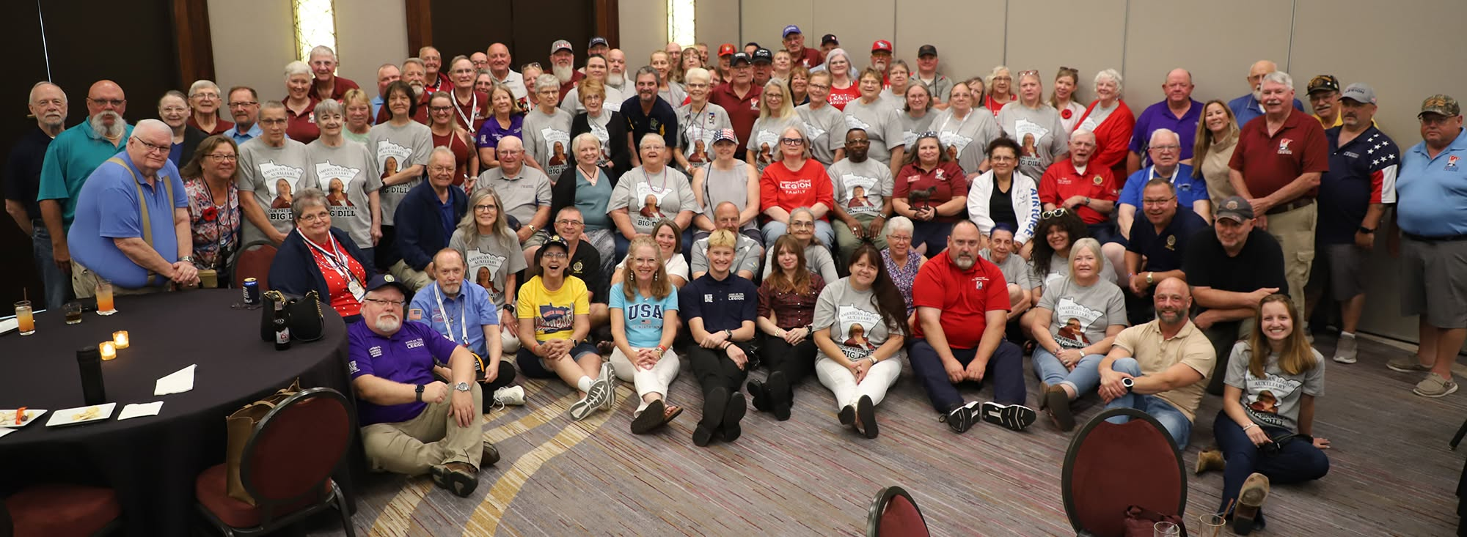
IDENTITY
BELONGING
PURPOSE
I am a Legionnaire.
There is a place for me here.
There is still something I can contribute.

Slide 5
5
PEOPLE
BEFORE
NUMBERS.

Slide 6
6
NUMBERS ARE THE RESULT.
PEOPLE ARE THE REASON.
People before numbers means understanding where the numbers come from.

Slide 7
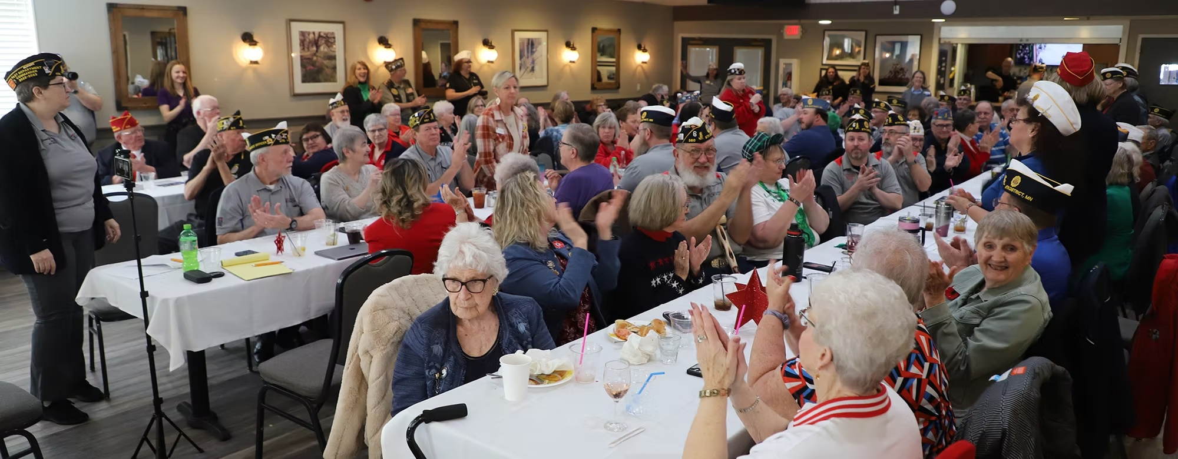
WHY DID YOU JOIN? WHY DID YOU STAY?
RELATIONSHIPS.

Slide 8
8
WE DON'T SELL
MEMBERSHIPS.
WE EXTEND
INVITATIONS.

Slide 9
9
RETENTION DOESN'T BEGIN
WITH A RENEWAL NOTICE.
It begins the day a veteran joins.

Slide 10
10
RENEWALS BEGIN
WITH BELONGING.
EVERY DAY.
A membership philosophy—not a renewal-season program.

Slide 11
11
THAT'S MY POST.

Slide 12
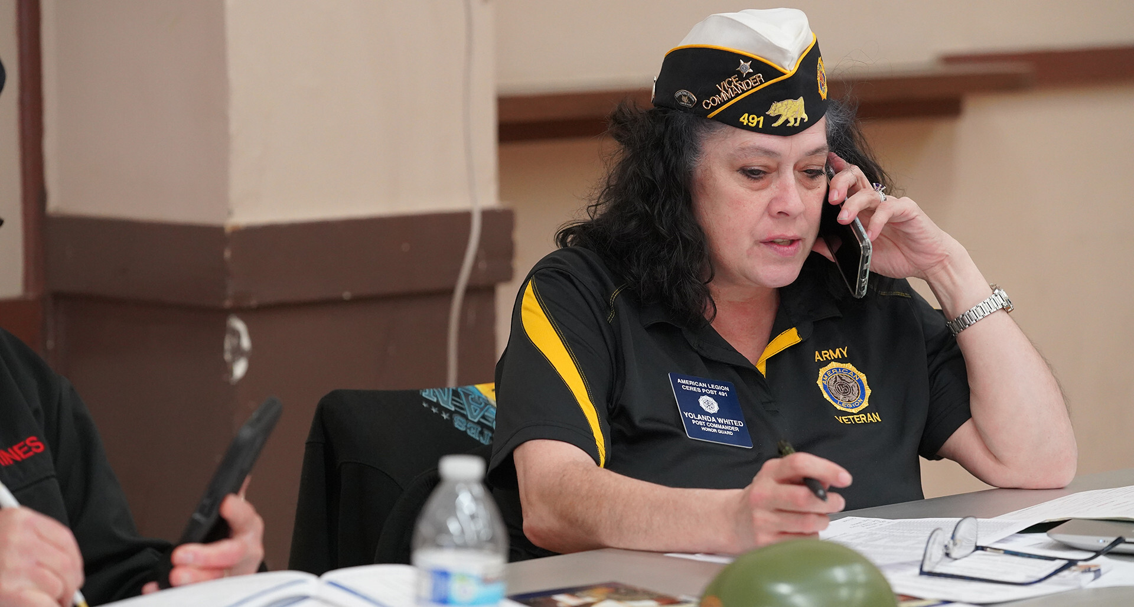
ONE
CONVERSATION.
“We haven’t seen you in a while.
How are you doing?”
A Buddy Check begins with concern—not dues.
Because when we build relationships,
we build stronger membership.

Slide 13
13
MEMBERSHIP IS A JOURNEY.
WELCOME
INVOLVE
MENTOR
LEAD

Slide 14
14
IT DOESN'T END WITH LEAD.
WELCOME
LEAD
INVOLVE
IT'S A CYCLE.
MENTOR

Slide 15
EVERY LEGIONNAIRE
IS PART OF THE
MEMBERSHIP TEAM.

Slide 16
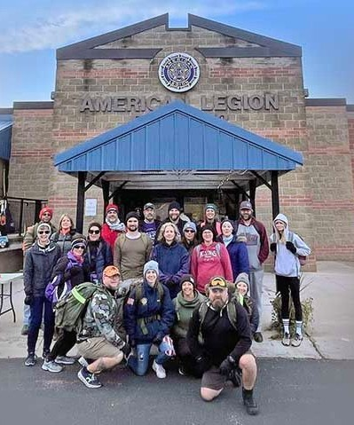
THAT'S
MY POST.

Slide 17
17
SO WHAT DO WE DO NOW?

Slide 18
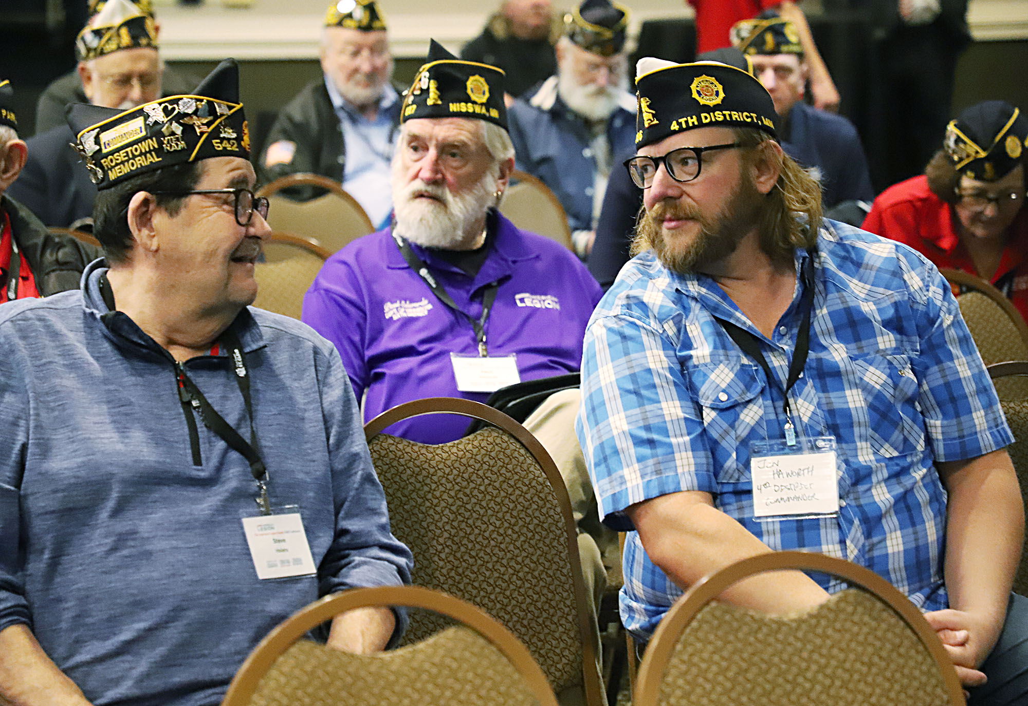
ONE VETERAN.
ONE LEGIONNAIRE.
ONE CONVERSATION.

Slide 19
19
ONE CONVERSATION
CAN CHANGE
EVERYTHING.

Slide 20
20
MY COMMITMENT TO YOU.
LISTEN • LEARN • SUPPORT • SHARE
Membership is everyone's responsibility.

Slide 21



21
ONE PHILOSOPHY. THREE RESOURCES.
GUIDE
PLAN
PLAYBOOK
Who are we?
Where are we going?
How do we get there?

Slide 22
22
INVEST IN
LEGIONNAIRES.

Slide 23
23
WHO WILL WRITE
WHAT COMES NEXT?

Slide 24
24
EVERY CONVERSATION.
EVERY INVITATION.
EVERY LEGIONNAIRE.
EVERY DAY.

Slide 25
THE NEXT CHAPTER IN
THE AMERICAN LEGION'S HISTORY
IS WAITING TO BE WRITTEN.
PICK UP THE PEN.

