Slide 1

Service Discharge Upgrades
(Discharge Review Board & Board for Correction of Military Records)
Provided in Partnership with the BCNR
Jeremy Wolfsteller, Department Service Officer, American Legion

Slide 2
Types of Discharges
Honorable
General Under Honorable Conditions
Other Than Honorable Non Punitive- (mostly administrative discharges)
Bad Conduct Discharge (Punitive discharge given by court-martial, special or General)
Dishonorable (General Court-Martial)
Entry Level Separation (Also uncharacterized prior to 180 days)

Slide 3
Advising Clients: BCMR or DRB?
Discharge character, reason, or reenlistment code? DRB or BCMR
Other relief (advancement, evaluation, pay)? BCMR only
Limitations on applying to DRB:
  Discharge must be less than 15 years ago
  Cannot review discharge awarded by General Court-Martial
  Cannot change narrative reason to “Physical Disability”
  Cannot reinstate petitioner into the Service
  Cannot award back pay or separation pay
Leverage all review opportunities:
  DRB document review
  DRB personal appearance
  BCMR petition
  Federal Court

Slide 4
BCMR Authority
“The Secretary… acting through boards of civilians… may correct any military record… when necessary to correct an error or injustice…” (10 U.S.C. §1552)
Mission: Correct errors or remove injustices from military records for Active Duty, Reserve, and former Service Members. The BCMRs seek to:
  Be accessible, transparent, fair, and efficient in assisting veterans seeking to correct their records;
  Provide an unbiased examination of service and other related records, and evenly present petitioners’ request and supporting materials to enable the Board to fairly render decisions.
Highest level of administrative appeal in the Department of the Army / Navy / Air Force.
  Decisions are “final agency action”
  Federal Courts apply an “arbitrary and capricious” standard of review”
Notes:
“With great power comes great responsibility.” --Voltaire (or, Stan Lee)

Slide 5
BCMR Authority
Powers are very broad
Board cannot change the law, but can change the facts in a military record to make them fit the law
  To remove an injustice, the Board can change a record to reflect the way things should be, rather than how they actually are
  Court martial findings cannot be changed; Board action(s) limited to clemency
Secretaries have delegated approval authority in many, but not all, cases to an Assistant Secretary, Senior Executive Service leader, or BCMR Executive Director
Notes:
“With great power comes great responsibility.” --Voltaire (or, Stan Lee)

Slide 6
BCMR Authority
BCMR can review decisions of other boards
  Petitioners must exhaust administrative remedies
  Discharges < 15 yrs old should be reviewed by Discharge Review Board
Limitations:
  Statute of Limitations: 3 years; may be waived in the interest of justice
  Reconsideration: By regulation requires “new and material evidence” within one year of BCMR decision (BCNR policy, the one year may be waived)
  No authority, sua sponte, to review records. BCMRs can only act on a petition from an individual veteran or directive by Service Secretary on behalf of a group similarly harmed by the same error or injustice.
  Cannot overturn court-martial convictions, but can grant clemency
  Cannot change records of other agencies, or actions taken by the President
  Service Secretaries have reserved final decision authority in some cases
  Burden on applicant to provide sufficient evidence to show it is “more likely than not” there was a material error or injustice
Not an Investigative Body
Notes:
“With great power comes great responsibility.” --Voltaire (or, Stan Lee)

Slide 7
 | ARMY | NAVY/MARINE | AIR FORCE
ORGANIZATION | Reports to Secretary through Review Board Agency | Direct report to Asst. Secretary (ASN(M&RA)) | Reports to Secretary through Review Board Agency
STAFF | 44 (28 examiners) | 30 (14 examiners) | 31 (21 examiners)
BOARD MBRS | 100 (GS13-SES) Appointed by Asst. Secretary (M&RA) | 60 (GS13 – SES). Appointed by ASN(M&RA) | 75 (GS15 – SES) Appointed by Dir, Rev. Bd. Agency)
PANELS | At least 3 mbrs. Each sit once per quarter | 3 mbrs. Each mbr sits approx one panel per month | 3 mbrs. Each mbr sits approx one panel per quarter
PRESENTATION | Case file / synopsis | Oral, w/brief sheet | Written, in advance
APPLICATIONS | 17,000 / YR | 15,000 / YR | 6000 / YR
BOARDABLE CASES | 9144 / YR | 7000 / YR | 3000 / YR

Slide 8
Typical Bases for Correction
Genuine Error
Changing Standards
Failure to Counsel
Regulatory Violations
Clemency
Any Circumstance that Creates an Injustice

Slide 9
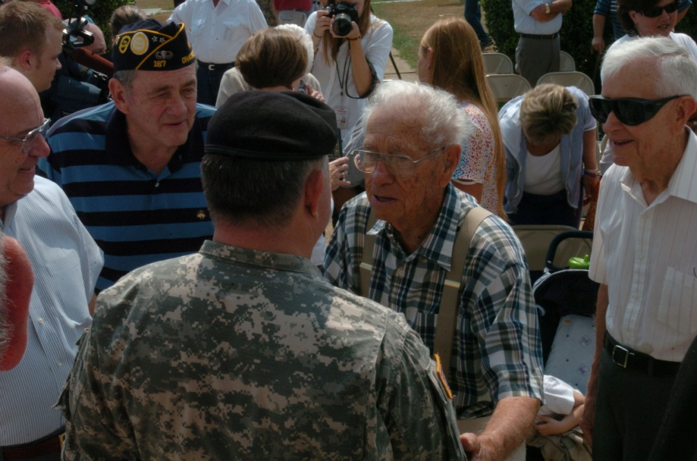
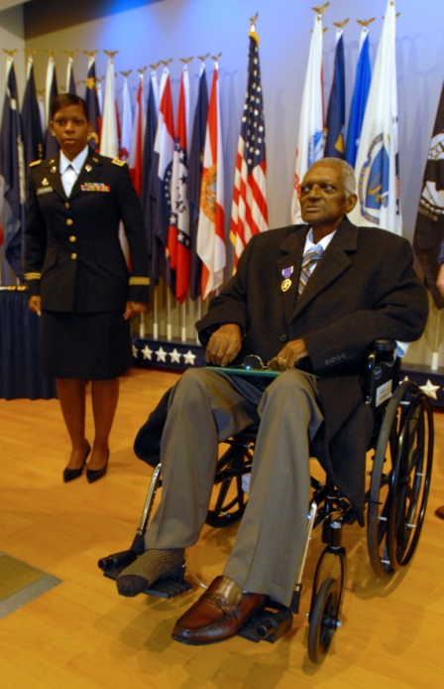
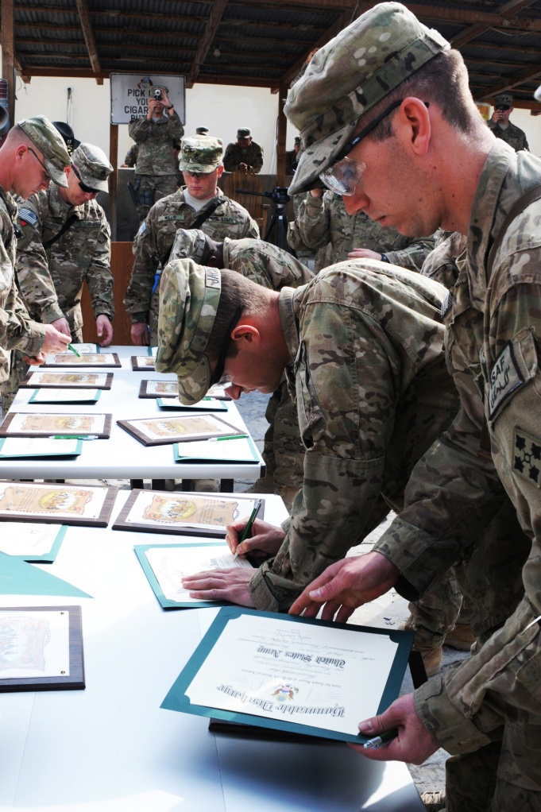
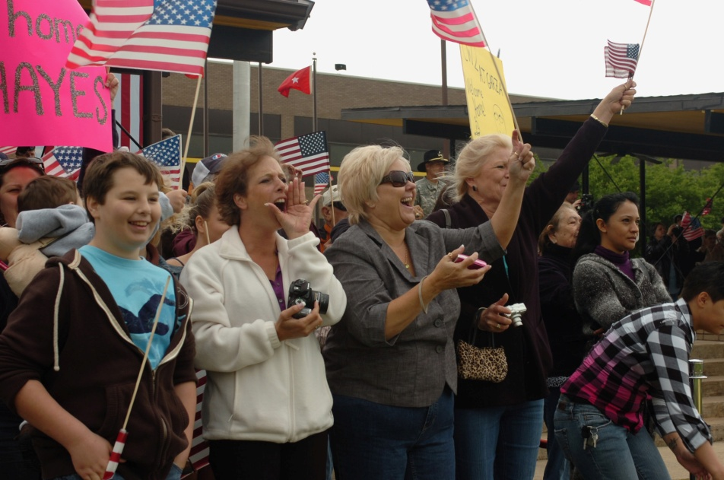
Typical Corrections
Awards
Separations / Discharge
Promotions
Retirements
Disability review
Evaluation Reports
Pay and Allowances
Survivor Benefit Plans
Home of Record
Clemency Petitions
Article 15 (UCMJ) Punishment
Memoranda of Reprimand

Slide 10
Applying to the BCMR
Applicants file form DD-149
  Articulate the (a) error, and/or (b) injustice that is alleged to have occurred
  Does not require an attorney
Best Practices
  Complete the DD 149 in its entirety
  Provide evidence to support the error and/or injustice, or explain why it is not available. BCMRs will request some service records (pre-1996, not available electronically)
  Explain why it is in the interest of justice to waive the statute of limitations, if applicable
  If a personal appearance is requested, articulate why granting it will be helpful to the Board
  Plain English and brevity. Not all reviewers are lawyers.
  Keep copies of the application and all supporting documents

Slide 11
BCMR Review
Staff analyzes the application
  Assembles facts from military records, advisory opinions, applicant’s supporting evidence, regulations and laws
  Some cases are administratively closed if there are no records, application is not appropriate for Board review, or issue can be corrected administratively
  Staff analysis and application materials are submitted to a Board for consideration and vote
  Presumption of administrative regularity
  Boards are not investigative bodies
  OSD guidance, applicable statutory and regulatory guidance
  Board decision is transmitted to the applicant and, if applicable, to appropriate staff office for implementation

Slide 12
BCMR Evidence
Articulate the Request, Articulate the Basis for the Request
BCMR is not an investigatory body
  Burden on applicant to provide sufficient evidence to show it is “more likely than not” there was a material error or injustice
  Presumption of Regularity: Absent contrary evidence, Board presumes officials acted in accordance with governing law/policy and in good faith
Presumption of Regularity – Administrative Law – absent contrary evidence, it is presumed that government officials acted in accordance with governing law/policy and in good faith based on available information
Applicant must provide sufficient evidence to show it is more likely than not there was material error or injustice
  Provide evidence supporting the request and the basis for the request

Slide 13
PTSD, TBI,MST, SA,SH
Secretary of Defense (SECDEF) policy memos of 3 Sep 14 and 26 Feb 16
In the past (e.g. Vietnam), PTSD and TBI were not recognized, so veterans’ records often lack information to determine whether PTSD / TBI contributed to / mitigated their discharge. Similarly, absent supporting information, MST/SA were not recognized as mitigating factors.
Policy applies to requests to change characterization of service, but BCMR nonetheless gives liberal consideration to PTSD, TBI, MST, etc. in other requests, too.
Give “liberal consideration” to symptoms or diagnoses indicating PTSD existed at time of discharge. Give “special consideration” to VA, military, and civilian determinations documenting PTSD.
Board analysis, application of liberal consideration
  Did PTSD exist at time of discharge? Medical diagnosis.
  If so, is it a mitigating factor in the circumstances leading to discharge?
Carefully weigh evidence of PTSD against seriousness of any misconduct
“PTSD is not likely a cause of premeditated misconduct.”

Slide 17
Cases Involving PTSD/TBI/MST/SA/SH
Statute of Limitations must be waived if Board finds PTSD or related condition (e.g. TBI). (Dep. Under SECDEF memo, 24 Feb 2016)
Board may obtain an advisory opinion from a Department of Defense (DOD) mental health (MH) professional in assessing presence of PTSD and its potentially mitigating effects.
  BCMRs have access to MH experts either on staff or through other offices if Board determines an advisory opinion is needed.
Cases previously reviewed by BCNR prior to SECDEF’s Sep 2014 policy must, upon request, be reconsidered de novo (completely anew).
Clarification on Mental Health, Sexual Assault, Sexual Harassment (25 Aug 17)

Slide 18
Liberal Consideration for PTSD/TBI/MST
OSD Training Guidance: Liberal Consideration is to be applied by DRBs, BCMRs, and applies to all characterizations, not just OTH
Usually FOUR QUESTIONS
    Did the Veteran have conditions/experience that may excuse/mitigate discharge?
    Did it exist/occur during military service?
    Did it excuse/mitigate discharge?
    Does it outweigh discharge?

Slide 19
Liberal Consideration
Continued
Liberal Consideration—if it’s reasonably possible, give Veteran benefit of the doubt.
  Some cases require more leniency from standards of proof—i.e. cases from 1960s and 1970s get more leniency than the case of someone who was discharged in the past two years and who has had the benefit of changes to policy
  PTSD/victimology better understood today
  Victim support/protections are greater today
  MH conditions, SA/SH impact people intimately and differently
  Relief should not require evidence unlikely for circumstances
  Some have difficulty making case because of condition/incident
  Honorable characterization does not require flawless service
  Severity of misconduct can change over time
  Commanders fully informed today often opt for less prejudicial discharge basis/characterization to enable medical care
  Does not mean relief is required
  LOWERS THE BURDEN IN THESE CASES; DOES NOT DICTATE ANY RELIEF

Slide 20
Other Policies
Military Sexual Assault: Where petitioner alleges he/she was a victim of sexual assault, consider
  The psychological and physical aspects of the petitioner’s experience in connection with the sex-related offense;
  The bearing such experience may have had on the circumstances surrounding the petitioner’s separation from the Armed Forces.
“Don’t Ask, Don’t Tell:” BCMRs will normally grant change of discharge (characterization, narrative reason, codes) if
  discharge was based solely on homosexuality (orientation, statement, act), and
  “there were no aggravating factors, such as misconduct.”
Name Changes:
  Applicant must demonstrate error or that having their former name on their DD-214 causes an injustice (e.g., divorce or new gender identity)
  Evidence should include court order showing applicant’s name was legally changed. However, even absent court order, Board considers each application on its own merits.
FOUO

Slide 21
Expectations for 2017/2018
  BCMRs expect continued attention from Congress/OSD
  Applications forms are being revised
  Clemency Guidance is underway
  Consolidated DODI/Federal Regulation on the horizon

Slide 22
Advising Clients
Build the administrative record at every stage of representation.
Tell client to obtain and retain DD-214, all admin separation records, medical documents, or other information needed for a BCMR case.
  Articulate the Request and the Basis for the Request
  Clarity and Organization of the Petition
  If VA files are cited to support the request, provide the VA files/documents to the BCMR
Understand the various boards in the Service Review Board Agencies. Apply to these boards first, if available.
Understand the BCMR’s authorities and limitations
  Has client exhausted administrative remedies?
  Is the case ripe yet for BCMR (e.g. DRB reviews discharges < 15 years old)?

Slide 23
Advising Clients - BCMR
Why does it often take months to receive a decision?
  Volume of cases/year, complexity of issues, and time required to obtain service record and advisory opinions.
What has BCMR changed in the last 12 months to improve response times?
  Reorganized manning, additional staffing, increased production, and implemented accountability metrics to understand and remedy delays.
  Attorney on staff; Doctor on staff
BCMR is making it easier for veterans to apply for relief.
  Added content to website to provide “best practices” and “how to” advice in building an application; as well as caseload and processing time information.
  Applications can now be sent by e-mail; on-line application will be developed.
  BCMR increased manning last year and is putting technology in place to allow more cases to be reviewed electronically, in order to reduce processing times.

Slide 24
Resources
BCMR Websites:
  Army – http://arba.army.pentagon.mil
  Navy/Marine Corps – www.secnav.navy.mil/mra/bcnr
  Air Force –www.afpc.af.mil/afveteraninformation/airforceboardforcorrectionofmilitaryrecords
  Websites include information on
    Boards and application procedures
Frequently Asked Questions and Answers
Printable DD Form 149 (BCMR) and DD Form 293 (DRB)
Online application (Army)
BCMR / DRB Electronic Reading Room: http://boards.law.af.mil/

Slide 25

QUESTIONS ?

